Slide 1
2024-2028
CONSOLIDATED PLAN & 2024 ANNUAL ACTION PLAN
ANALYSIS OF IMPEDIMENTS TO FAIR HOUSING CHOICE OVERVIEW
CITY OF DALTON, GA
300 WEST WAUGH ST
DALTON, GA 30720

Slide 2
5 – YEAR CONSOLIDATED PLAN &
ANNUAL ACTION PLAN
The Consolidated Plan is designed to help jurisdictions to assess their affordable housing and community development needs and market conditions, and to make data-driven, place-based investment decisions.
Serves as the framework for a community-wide dialogue to identify housing and community development priorities that align and focus funding from the Community Development Block Grant Program.
The Consolidated Plan is carried out through Annual Action Plans, which provide a concise summary of the actions, activities, and the specific federal and non-federal resources that will be used each year to address the priority needs and specific goals identified by the Consolidated Plan.

Slide 3
THE PROCESS
When developing a Consolidated Plan, a grantee must first analyze the needs within its jurisdiction and then propose strategies to meet those needs.
1.The Needs Assessment and Market Analysis outline levels of relative need in the areas of affordable housing, homelessness, special needs, and community development.
2.Once finished, these portions of the Consolidated Plan form the basis of the Strategic Plan. The Strategic Plan details how the grantee will address its priority needs. The strategies must reflect the current condition of the market, expected availability of funds, and local capacity to administer the plan.

Slide 4
THE PROCESS
Consolidated Plan is part of a larger grants management and planning process that can be divided into six phases:
Determining needs
Setting priorities
Determining resources
Setting goals
Administering the programs
Evaluating performance.

Slide 5
ANALYSIS of Impediments (AI)
to Fair Housing Choice
Analysis of Impediments (AI) to Fair Housing Choice is required for all recipients of grant funds from HUD.
What is an Impediment to Fair Housing Choice? Impediments to fair housing choice are defined as: any actions, omissions, or decisions taken because of race, color, religion, sex, disability, familial status, or national origin that restrict housing choice or the availability of housing choice.
What is Fair Housing Choice? Fair housing choice is defined as the “ability of persons, regardless of race, color, religion, sex, national origin, familial status, or handicap, of similar income levels to have available to them the same housing choices.”

Slide 6
What Is The Purpose Of The AI?
The purpose of the AI is to:
Evaluate the housing characteristics
Identify blatant or defacto impediments to fair housing choice, and
Establish a strategy for the expansion of fair housing opportunities
Why Does The City Need To Do This Plan?
HUD requires jurisdictions to certify that they will affirmatively further fair housing by:
Conducting an analysis of impediments to fair housing choice,
Taking appropriate actions to overcome the effects of impediments identified through that analysis, and
Maintaining records reflecting the analysis and actions.
Analysis of Impediments (AI) to Fair Housing Choice

Slide 7
Analysis of Impediments (AI) to Fair Housing Choice

Slide 8
Impediments (AI) to Fair Housing Choice
Impediment 1: Housing Affordability/Cost Burden
High rents in relationship to the earnings of average workers put housing affordability out of the reach for many. Housing is the largest monthly cost for most households
Recommendations:
Leverage Tenant Based Rental Assistance as an interim solution for housing affordability.
Explore re-purposing of existing real estate to include strip malls and extended stay hotels into rental units, including single room occupancy (SRO) options.
Provide tax incentives for apartment owners or owners of secondary residential properties who are willing to set aside a certain number of their existing apartments / homes as affordable housing.
Encourage more private sector investment in existing affordable housing properties to supplement federally funded efforts.
Develop Economic Development activities that will provide opportunities for small businesses to grow their customer base in their pursuit of sustainability.

Slide 9
Impediments (AI) to Fair Housing Choice
Impediment 2: Inadequate Fair Housing Education and Awareness in Community especially for LEP populations
As the City continues to expand with an increasingly diverse population, fair housing education must be continuous and presented in a context that is relative to the current community concerns.
Recommendations:
Increase the supply of affordable housing for renters and homeowners by supporting the development of inclusive housing projects by leveraging federal, state, and local public funding with private sector funding.
Expand its fair housing education and outreach efforts to groups that are underrepresented in its pool of clients to help continue to keep the public informed of their rights and specifically targeting more efforts in minority areas.
Fund and promote Fair Housing Education and Housing Counseling activities with CDBG Public Service funds.
Develop a Fair Housing Education Campaign to increase public awareness of fair housing rights.
Seek public and private partners to disseminate fair housing information to residents.

Slide 10
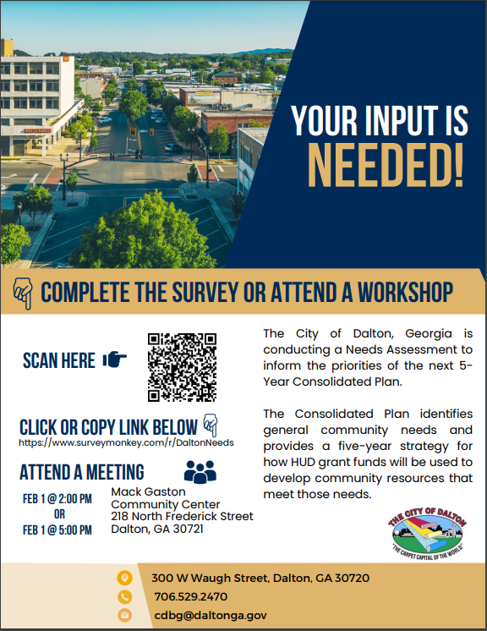
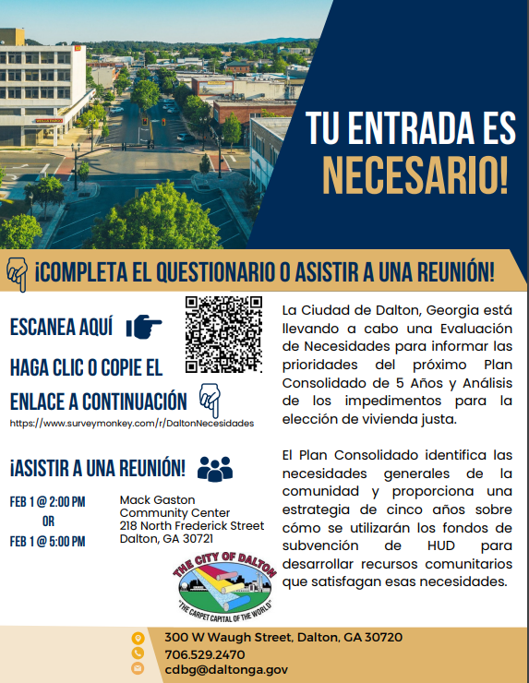
NEEDS ASSESSMENT SUMMARY
The City’s Needs Assessment Survey opened on
January 10, 2024 and closed on February 15, 2024.

Slide 11
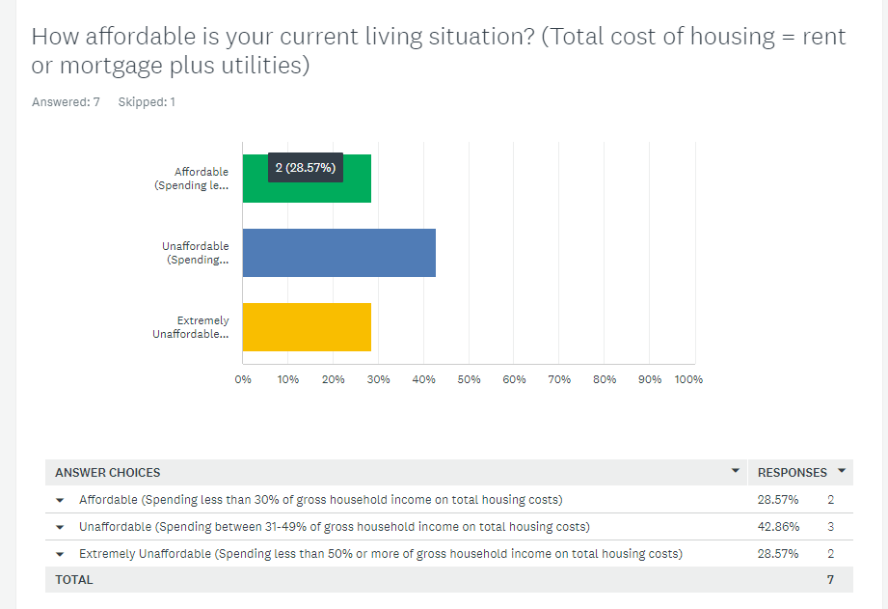
SURVEY RESULTS

Slide 12
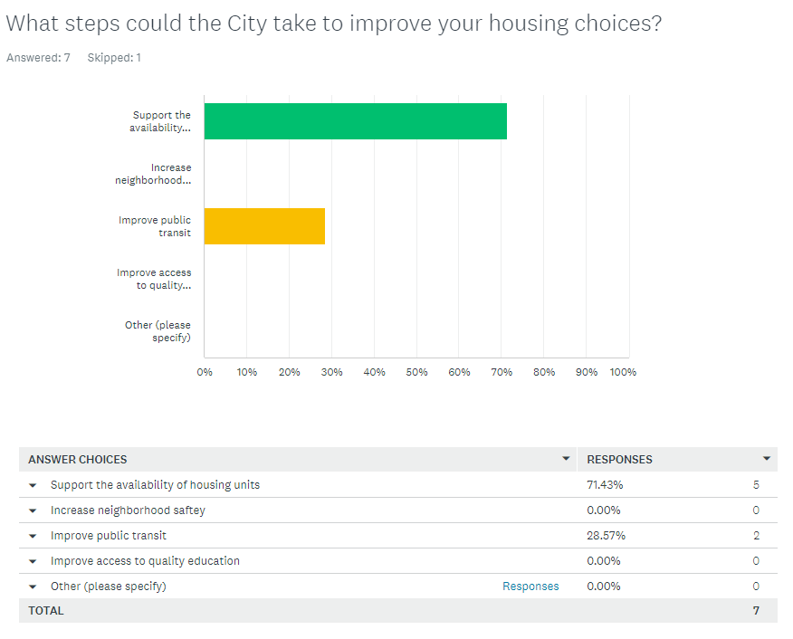
SURVEY RESULTS

Slide 13
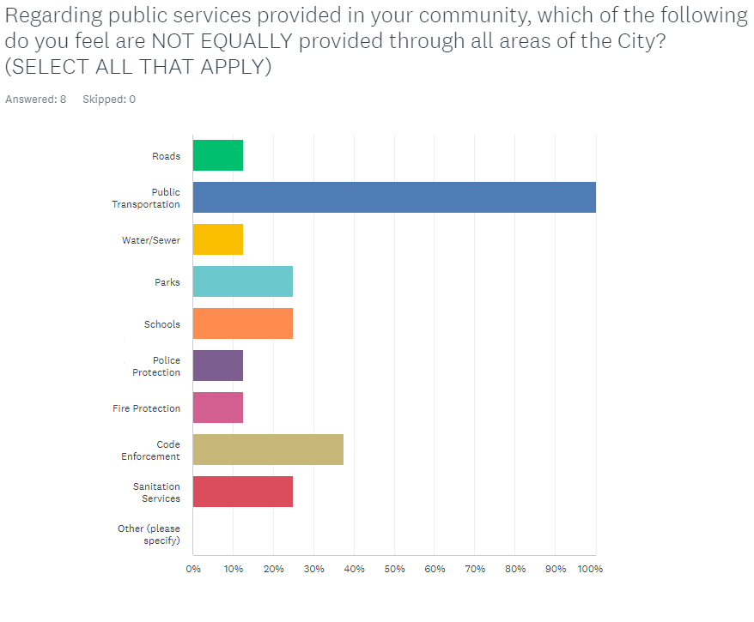
SURVEY RESULTS

Slide 14
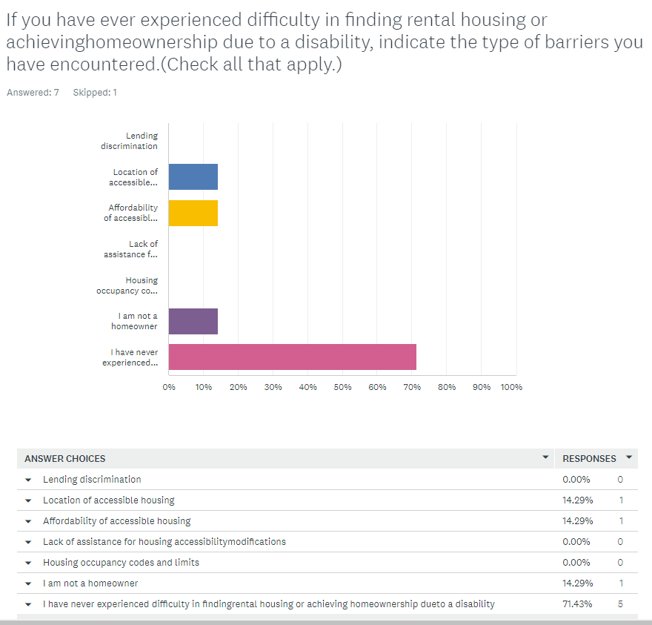
SURVEY RESULTS

Slide 15
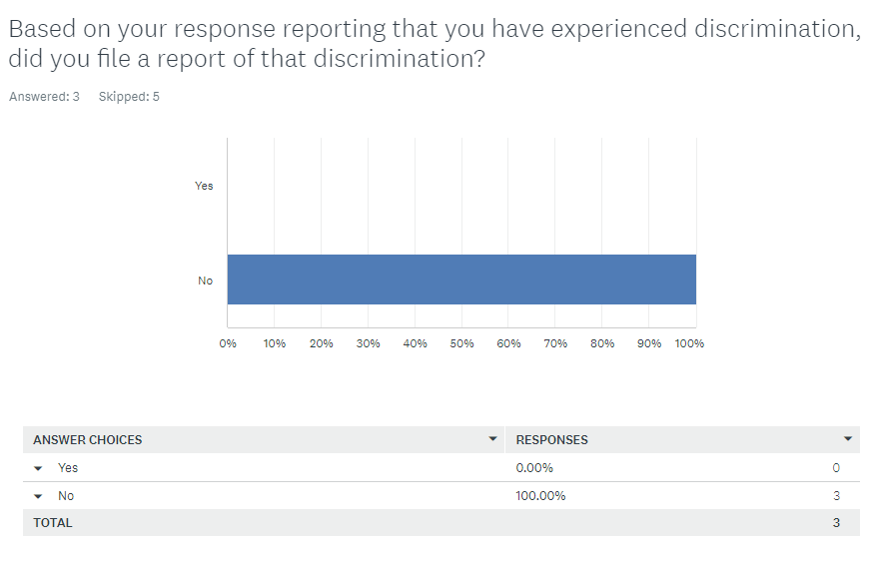
SURVEY RESULTS

Slide 16
PLAN PRIORITIES
The Consolidated Plan details the Priority Needs that will be addressed as reflected from the current conditions of the market, expected availability of funds, and needs assessment results.
The City’s Priority Needs include:
Increase Access to Decent Affordable Housing
Increase Access to Public Services
Public Facility & Infrastructure Improvements
Affirmatively Furthering Fair Housing
Planning and Administration

Slide 17
GOALS
Once priorities have been established, annual goals can be set based on the availability of resources, and local organizational capacity.
The City’s Goals include:
Home repairs for Homeowners
Rental Rehabilitation
Public Facility Improvements
Public Services
Fair Housing Education
Provide Administrative Structure

Slide 18
FUNDING ALLOCATION
CDBG is a formula grant
Annual allocations are announced to entitlement communities, states and Puerto Rico once
Congress has passed a budget.
Grant allocation amounts are based on:
Population
Poverty
Housing overcrowding

Slide 19
2024 FUNDING ALLOCATION
As of April 11, 2024, HUD has not released the 2024 CDBG allocations. In an effort to ensure timely reporting, the City has estimated the 2024 allocation at the amount below reflective of its 2023 CDBG funding of $367,688:
$368,000

Slide 20
2024 CDBG PROJECTS
FY2024-25 CDBG allocation (new $) -368,000
Applicant | Project Type/Matrix Code | Project Description | Requested Funding
Latin American Association | Public Services - 05 | Latino Family Well-Being Program | $ 25,000.00
NW Georgia Family Crisis Center | Public Services - 05 | Domestic Violence Client Advocate Salary | $ 25,000.00
Dalton Housing Authority | Residential Multi-Unit Rehab - 14B | HVAC Replacement for Beechland Property Phase 8 - 22 units | $ 122,200.00
City of Dalton | Planning & Administration - 21A | Planning & Administration | $ 73,600.00
City of Dalton | Residential Single-Family Rehab - 14A | Residential Housing Rehab Program | $ 122,200.00
TOTAL |  |  | $ 368,000.00

Slide 21
NEXT STEPS
Draft copies of the Five-Year 2024-2028 Consolidated Plan, 2024 Annual Action Plan, and Analysis for Impediments to Fair Housing Choice will be available for the 30-day comment period on Monday, April 1, 2024.
A Public Review Meeting will be held on Thursday, April 11, 2024 to solicit comments on the Draft 2024-2028 Consolidated Plan, 2024 Action Plan & 2024 Analysis of Impediments to Fair Housing Choice.
The City will receive written comments on the drafts until 5:00 P.M. on Wednesday, May 1, 2024.

