Slide 1
CITY OF DALTON
2025 CDBG GRANT APPLICATION OVERVIEW
Applications Accepted:
Thursday, January 23, 2025 – Wednesday, February 26, 2025

Slide 2
OPEN GRANT APPLICATIONS
GRANT PROGRAM OVERVIEW
MINIMUM APPLICATION REQUIREMENTS
AGENDA
LONG TERM GRANT REQUIREMENTS
APPLICATION PREVIEW
HELPFUL APPLICATION TIPS
QUESTIONS & ANSWERS

Slide 3
OPEN GRANT APPLICATIONS
Program Year 2025 [July 1, 2025 – June 30, 2026 ]
Applications will be accepted from non-profit organizations in the City of Dalton.
Community Development Block Grant (CDBG) Program
Public Facilities & Improvements, Economic Development & Housing Activities
Public Services Activities
CDBG PROGRAM APPLICATIONS CAN BE DOWNLOADED AT:
https://www.daltonga.gov/finance/page/applications-cdbg-programs

Slide 4
GRANT PROGRAM OVERVIEW
Community Development Block Grant (CDBG)
The United States Department of Housing and Urban Development (HUD) through the CDBG program provides communities with resources to address a wide range of unique community development needs. The CDBG program provides annual grants on a formula basis to Entitlement Communities as a means to support viable communities by providing decent housing, a suitable living environment, and opportunities to expand economic opportunities, principally for low and moderate-income persons.
Common CDBG Public Services Activities:
Not inclusive of all eligible CDBG Public Services.
Job Training
Child Care
Health Care
Fair Housing Outreach
Services for Seniors and Homeless Persons
Recreational and Educational Programs
Common CDBG Public Facilities Activities & Improvements, Economic Development, Housing Activities
Acquisition
Commercial/Residential Rehabilitation
Removal of Architectural Barriers for Accessibility
Construction/ Reconstruction
Low-mod job creation or retention activities

Slide 5
MINIMUM APPLICANT REQUIREMENTS
Nonprofit status for at least one (1) full year, or two (2) full years of operating as a subsidiary (a corporation owned or controlled in whole or in part) of a nonprofit entity, or a local governmental entity or agency within Dalton.
Verification of registration with the Georgia’s Secretary of State Office at the time of application.
Verification of registration with the U.S. System for Award Management and be free from debarment.
An active Board of Directors within the last 12 months.
The applicant must have an audit or prepared by a qualified accountant or accounting service, covering the last two most recent reporting periods of operation. Open Audit findings will make the applicant ineligible to receive assistance.
Written copy of financial management procedures, including staff responsibilities and required procedures.
At least twelve (12) months experience directly related to the proposed project or program.
Proof of insurance for the following types of insurance: General Liability, Auto Liability, and Worker’s Compensation (if applicable).

Slide 6
LONG-TERM REPORTING & PROGRAM ACTIVITY REQUIREMENTS
Programmatic and Expenditure Reporting
Long-term programmatic reporting requirements (CDBG: 5 years) and monthly expenditure standards
Annual submission of organization’s financial audit
Recordkeeping Requirements
Separate case files by grant per client must be maintained.
Case files must include grant eligibility documentation and must be determined & documented prior to providing services.
On-site visits, Technical Assistance, Desk Reviews, and Monitoring
Compliance monitoring will be conducted annually.
On-site technical assistance visits will be conducted regularly.

Slide 7
APPLICATION OVERVIEW

Slide 8
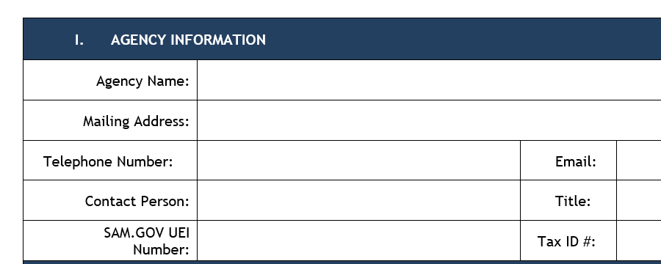
APPLICATION SECTIONS 1-2
Project Priority
If your organization submits multiple applications for the same grant, select the priority of importance.

Slide 9
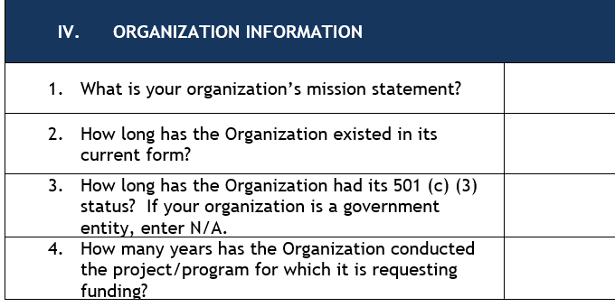
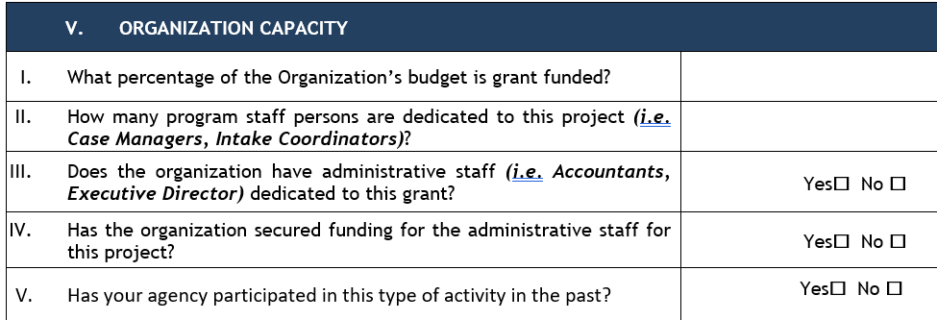
APPLICATION SECTIONS 3-5
Requested Funding
The total amount requested should match the amount listed on the Budget Sheet.

Slide 10
APPLICATION SECTIONS 6-7
Target Population
CDBG: 51% of the beneficiaries served must be L/M income persons.

Slide 11
CDBG PUBLIC FACILITY ACTIVITIES NARRATIVE SECTION 7
Narrative
Public facility activities based on Area Benefit must have at least 51% of the residents who are L/M income persons.
Activities serving a L/M Income Limited Clientele, which provides benefits to a specific group of persons or at least 51% of the beneficiaries served through the activity must be L/M income persons.

Slide 12
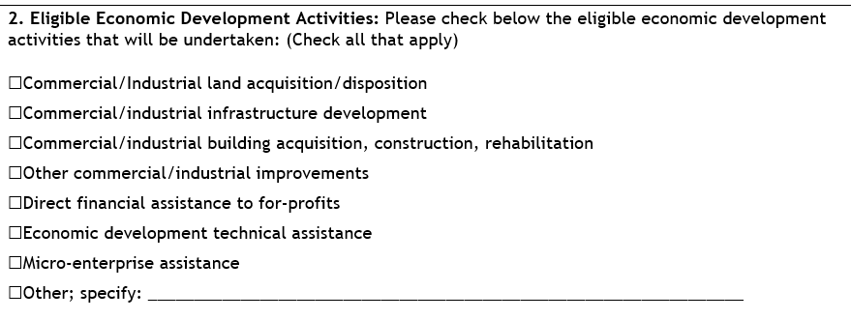
CDBG ECONOMIC DEVELOPMENT ACTIVITIES APPLICATION SECTION 8
Describe the type of Economic Development activity:
Type of Funding
Eligible activity
Estimated Full-time Private Sector Jobs Created/Retained (if applicable)
Describe Types of Private Sector Jobs Created/Retained (if applicable)
Estimated number of businesses Assisted (if applicable)
Please provide a description of the proposed project for funding.
Summary of Project Need and Justification.
12

Slide 13
CDBG HOUSING RELATED ACTIVITIES
SECTION 8
Narrative
Describe the type of Housing Related activity.

Slide 14
CDBG PUBLIC FACILITIES APPLICATION SECTION 9
Leveraging & Timetable
Describe leveraging funds to support your project.
Describe the project timeline, including preparation activities, procurement actions, and all activities up to occupancy of the facility.

Slide 15
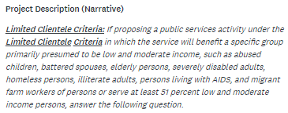
CDBG PUBLIC SERVICES NARRATIVE SECTION 7
Narrative
Describe project in detail and organization’s experience in recordkeeping.

Slide 16
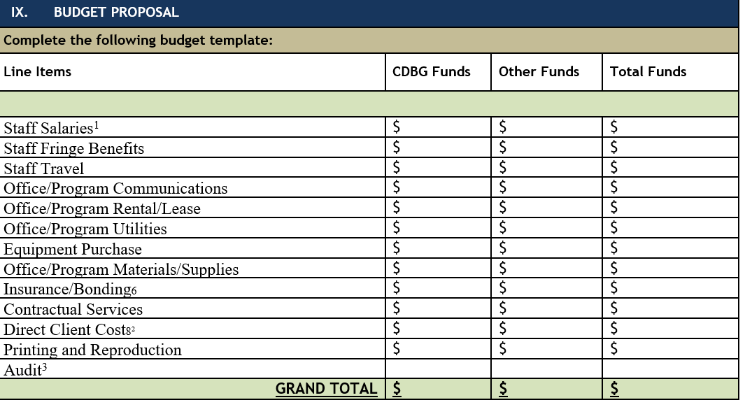
BUDGET SECTION 9
Applies to all
Grant Applications
Budget
Total amount of grant funds should match the same number written in Section III of the application. The budget reflects eligible activities to the respective grants. The “Other Funds” column should reflect other secured funding.
Allocating Costs
Costs billed to grant must be directly associated to the eligible activity being funded through the grant program.
Reminder: Check Your Numbers for Accuracy!!!

Slide 17
BUDGET PROPOSAL NARRATIVE
Applies to all
Grant Applications
Budget Narrative
Describe in detail how will grant funds be used to support your program. Provide detail of all funding secured for this project currently and additional funding awarded in the past three years.

Slide 18
CERTIFICATONS
Applies to all
Grant Applications
Conflict of Interest
Please check the appropriate boxes regarding Conflict of Interest, Acknowledgement of Responsibility, & Certification for Compliance with CDBG Regulations.
Organizations with a relationship with City Council will not be excluded from funding.
Authorized Representative
Remember to sign and date your application.

Slide 19
HELPFUL APPLICATION TIPS
Important points to consider before completing the CDBG applications.

Slide 20
PREPARING THE GRANT APPLICATION
A strong grant proposal should be clear, concise, and compelling. Make sure that the application provides enough detail that the funder understands your project. Your grant proposal should also tell a story that helps the reviewer to understand the Organization’s project.
Provide detailed project descriptions and performance outcomes.
Make sure the service population is clearly identified.
Describe record-keeping and/or reporting methods.
Ensure that the proposal narrative in the grant application corresponds to an eligible CDBG program activity.
Proofread your application prior to submission.
Allow sufficient time to complete the application.

Slide 21
ORGANIZATION’S CAPACITY
Organizational and Administrative Capacity
Clear plans and internal policies to deliver the proposed services.
Adequate staff dedicated to the project to deliver the proposed services.
Grants Manager, Accountant, Administrative Assistant
A formalized system for tracking annual performance outcomes.
A formalized system for ensuring compliance with record keeping and completing monthly programmatic reports: It is required that Organizations keep paper copies of client records.

Slide 22
ORGANIZATION’S CAPACITY
Financial Capacity
CDBG is a reimbursable grant. Therefore, funding is provided to grant subrecipients after expenses have been incurred by the agency.
Grant funds are reimbursable to the receiving agency based on actual receipts submitted for eligible projects.
Reimbursements are processed by the City after funding is released from the HUD; not often at the start of the program year.
In the application, clearly indicate the organizational financial capacity in the application to front program costs.
Overall, consider what percentage of the agency’s budget is grant funded in determining if projects can be sustained in the case of delayed reimbursements.

Slide 23
LEVERAGING & COLLABORATION
Collaboration and Resource Leveraging can improve your capacity by working with others that complement your mission and allow smaller organizations to learn from experts in the field.
Grant applications should identify organization’s partners and leveraging resources from other sources.
Provide a description of other funding the organization has secured other resources (grant or private funds) to use for the proposed activity.

Slide 24
City of Dalton
CDBG Program Office
300 West Waugh Street
Dalton, GA 30720
Email: cdbg@daltonga.gov
Phone: 706-529-2470

